Slide 1



Embedded Software Desig
n, Development
ards
processes & Stand
Mr. Bhargav N.
Restricted Circulation | L&T Technology Services | www.LTTS.com

Slide 2

Agenda
Process
Embedded Product Development Phases
Various Models for Embedded Product Development
System Requirements
System Design
System Implementation System Testing
Restricted Circulation | L&T Technology Services | www.LTTS.com
2

Slide 3

Process
Restricted Circulation | L&T Technology Services | www.LTTS.com

Slide 4
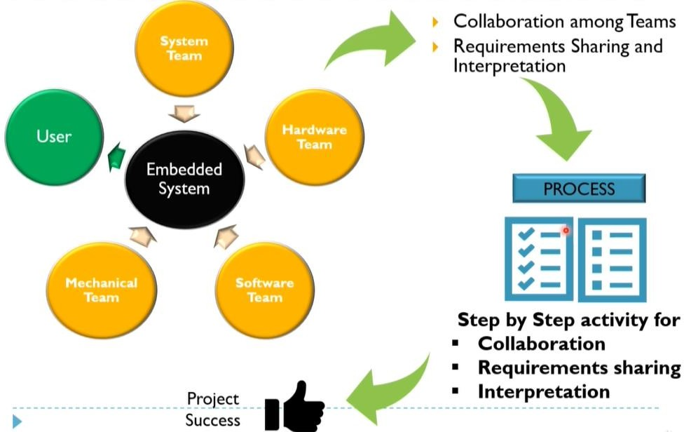
Why Process ? What is Process ?
Restricted Circulation | L&T Technology Services | www.LTTS.com

Slide 5
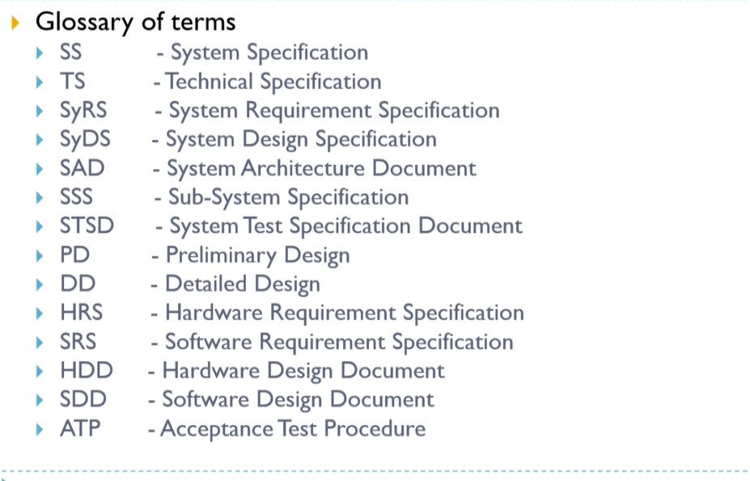
Vocabulary
Restricted Circulation | L&T Technology Services | www.LTTS.com

Slide 6
Embedded Product Development Phases
Restricted Circulation | L&T Technology Services | www.LTTS.com

Slide 7
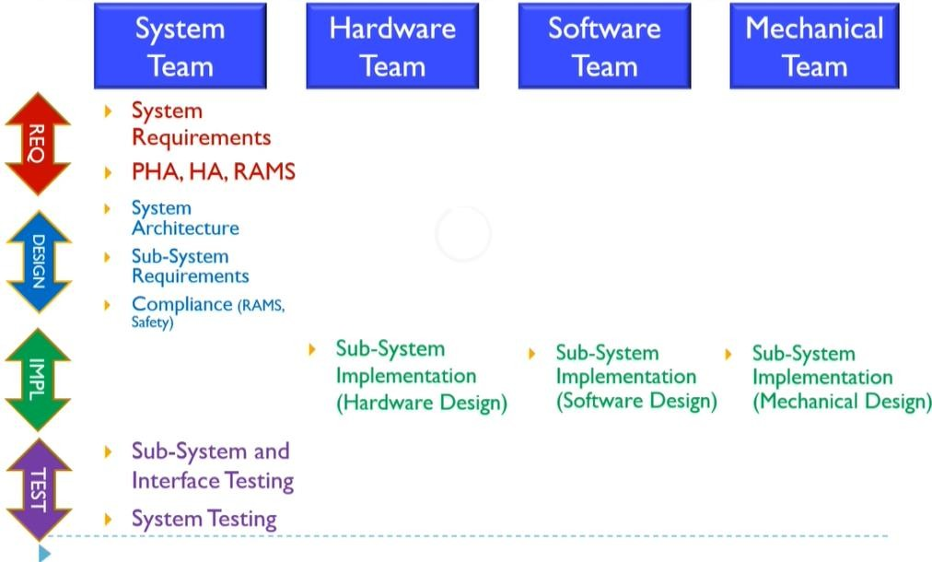
Embedded Product Development Phases
Restricted Circulation | L&T Technology Services | www.LTTS.com
7

Slide 8
Various Models for Embedded Product Development
Restricted Circulation | L&T Technology Services | www.LTTS.com

Slide 9
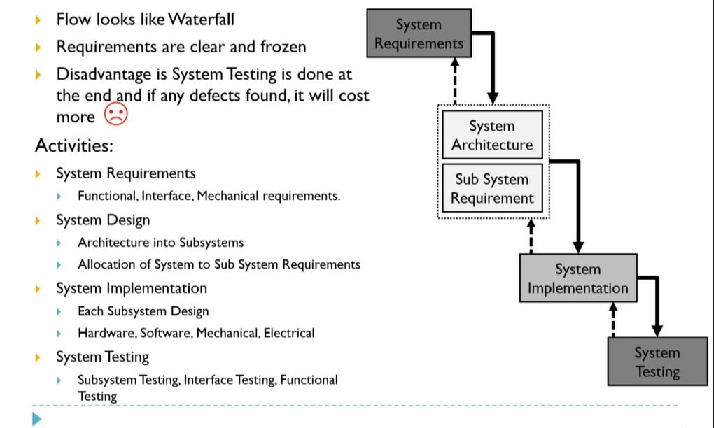
Waterfall Model
Restricted Circulation | L&T Technology Services | www.LTTS.com
9

Slide 10
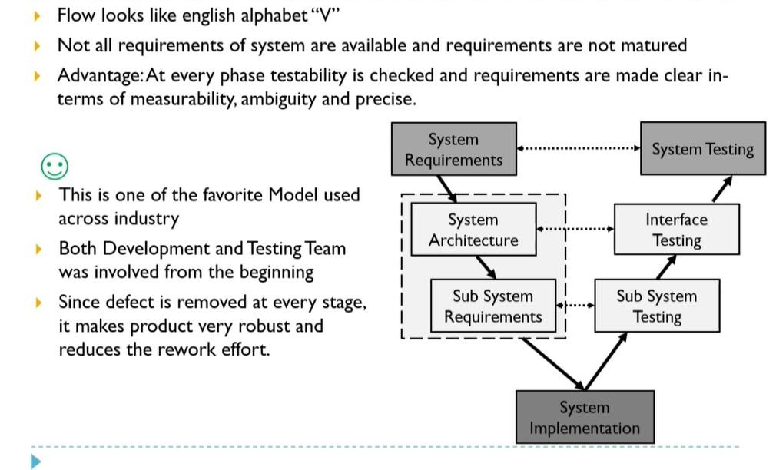
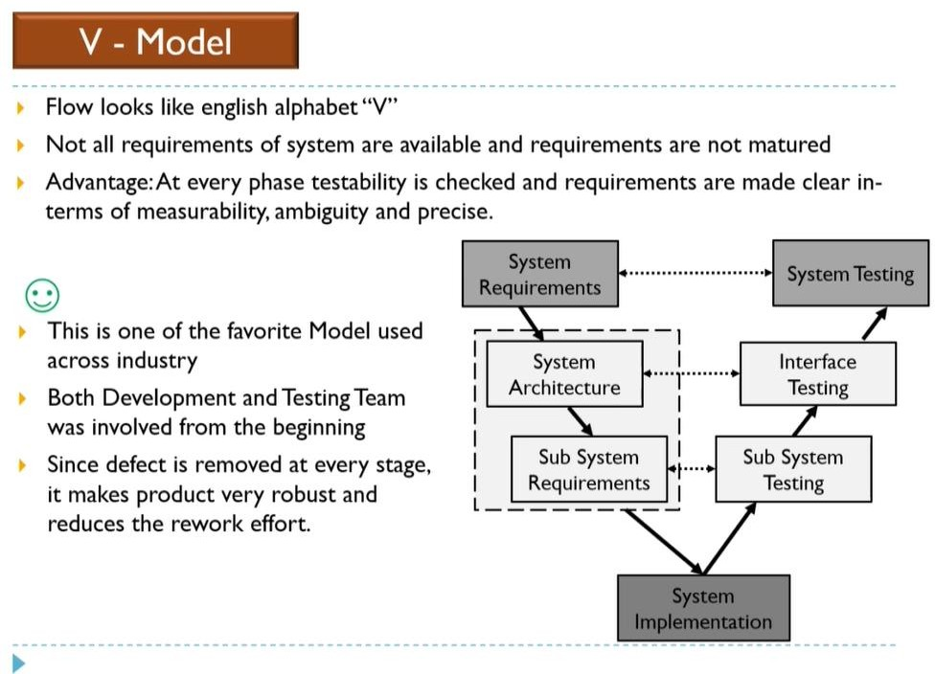
V Model
Restricted Circulation | L&T Technology Services | www.LTTS.com

Slide 11
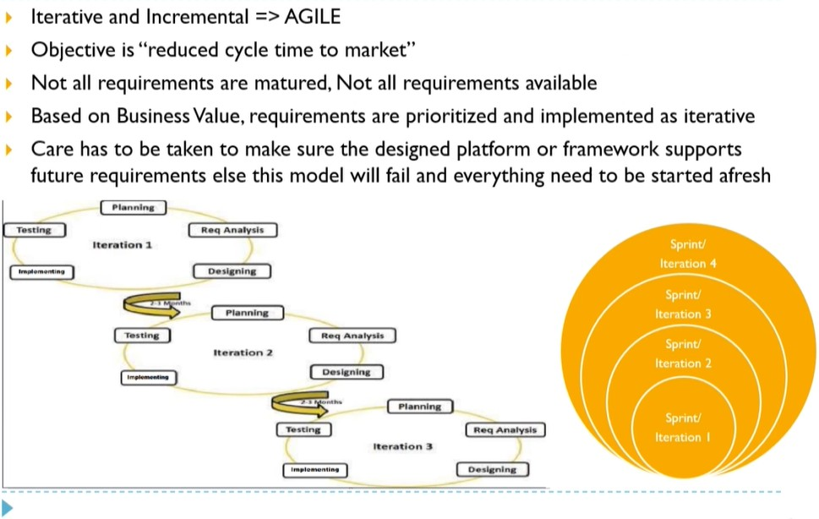
AGILE Model
Restricted Circulation | L&T Technology Services | www.LTTS.com

Slide 12
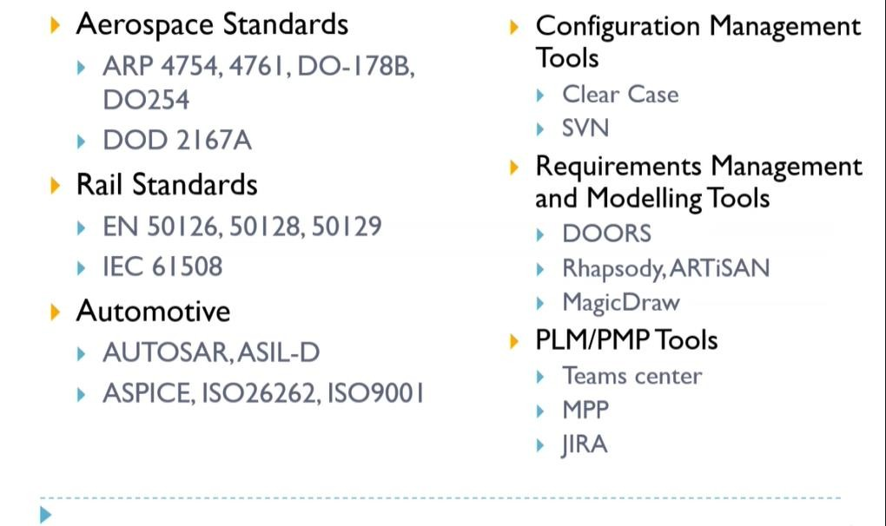
Standards and Tools
Restricted Circulation | L&T Technology Services | www.LTTS.com

Slide 13
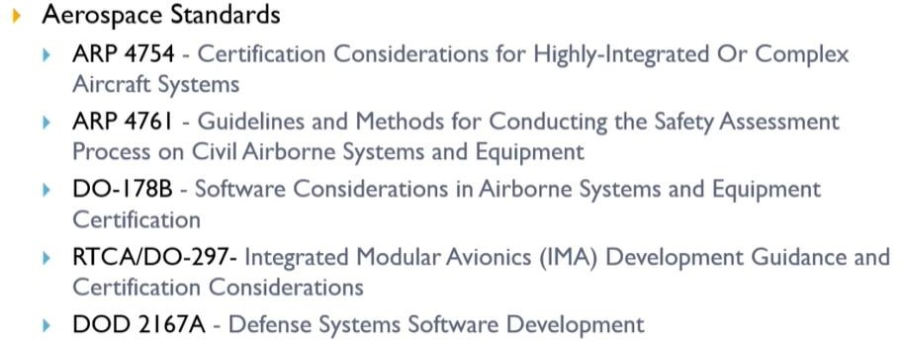
Aerospace Standards
Restricted Circulation | L&T Technology Services | www.LTTS.com

Slide 14
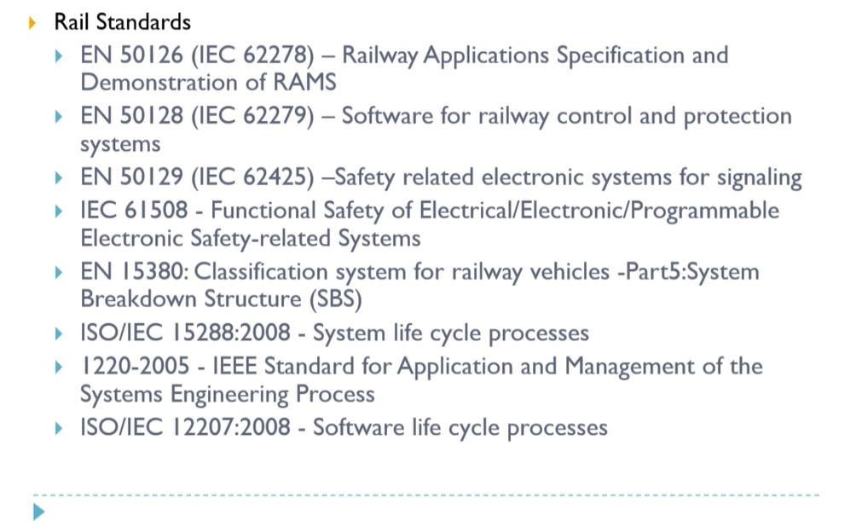
Rail Standards
Restricted Circulation | L&T Technology Services | www.LTTS.com

Slide 15
System Requirements
Restricted Circulation | L&T Technology Services | www.LTTS.com

Slide 16
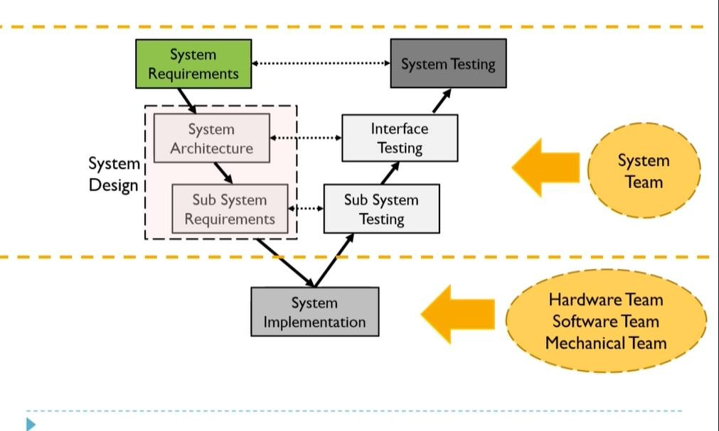
V Model
Restricted Circulation | L&T Technology Services | www.LTTS.com

Slide 17
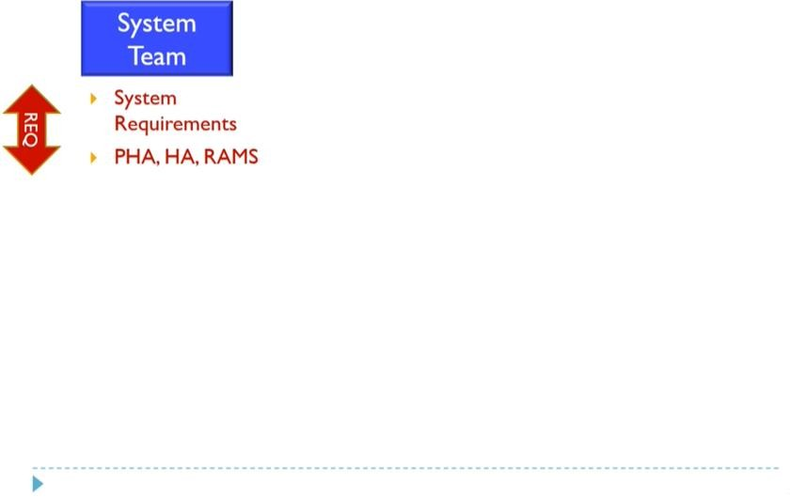
Requirements
Restricted Circulation | L&T Technology Services | www.LTTS.com

Slide 18
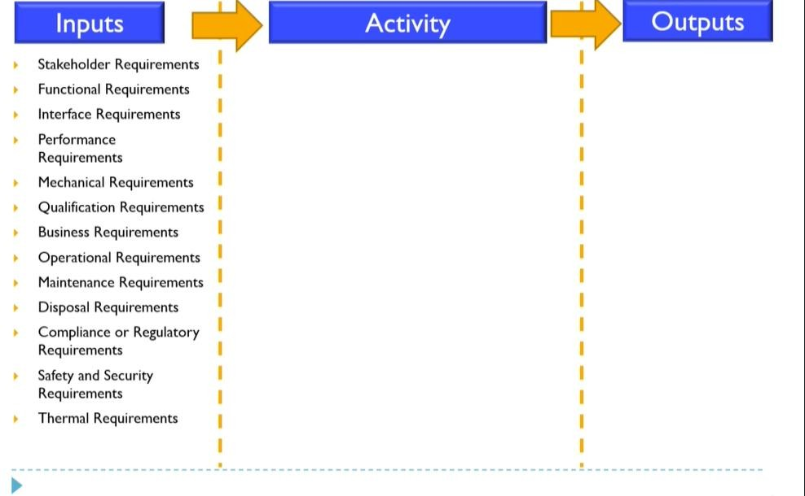
Input: System Requirements
Restricted Circulation | L&T Technology Services | www.LTTS.com

Slide 19
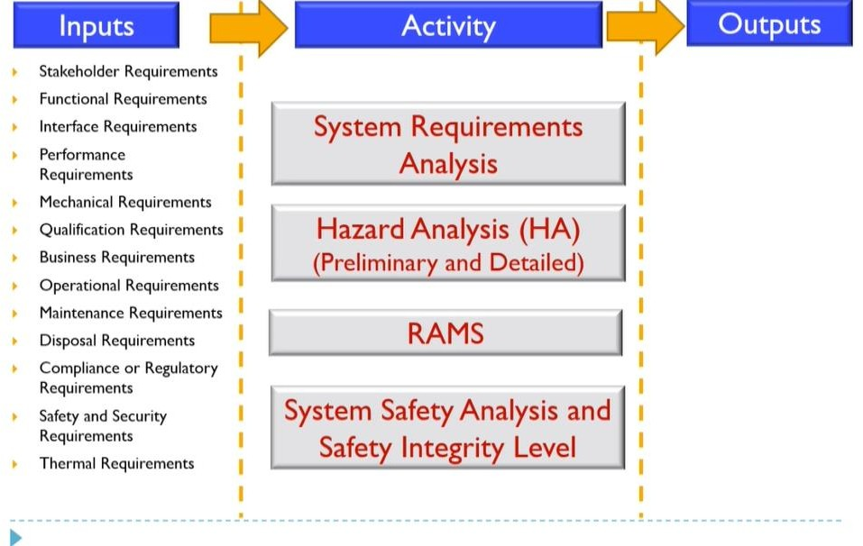
Activity: System Requirements
Restricted Circulation | L&T Technology Services | www.LTTS.com

Slide 20
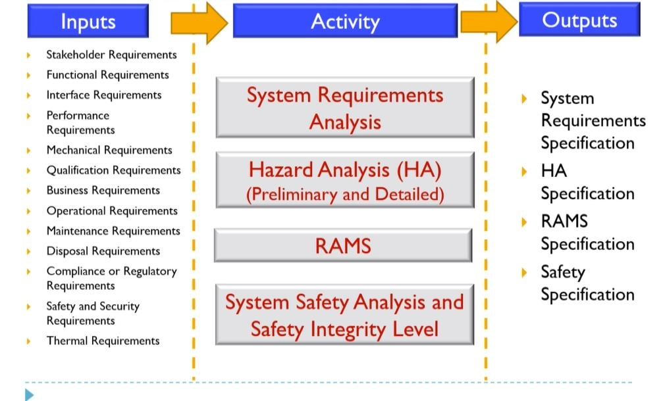
Output: System Requirements
Restricted Circulation | L&T Technology Services | www.LTTS.com

Slide 21
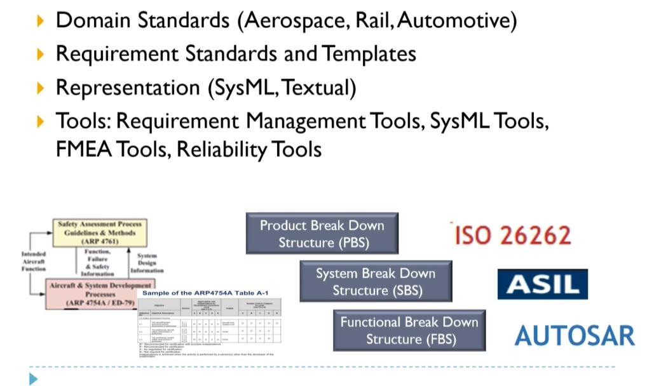
Standards and Tools
Restricted Circulation | L&T Technology Services | www.LTTS.com

Slide 22
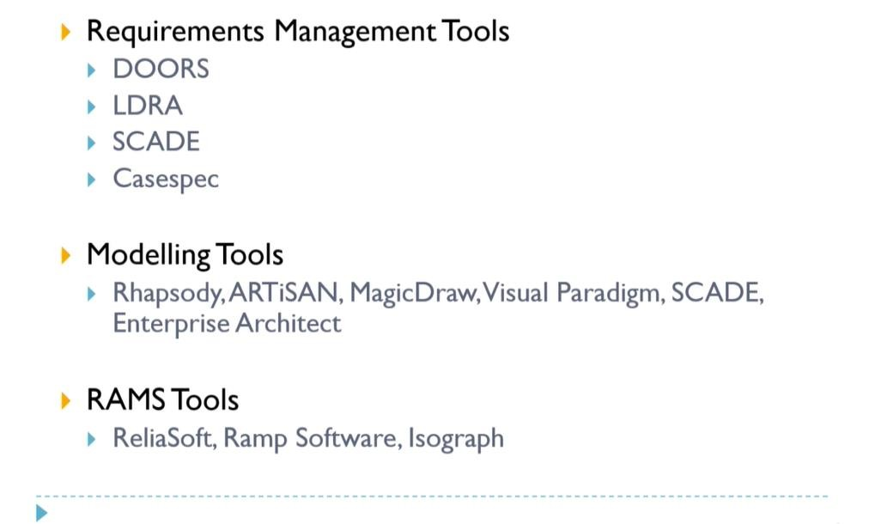
Standards and Tools
Restricted Circulation | L&T Technology Services | www.LTTS.com

Slide 23
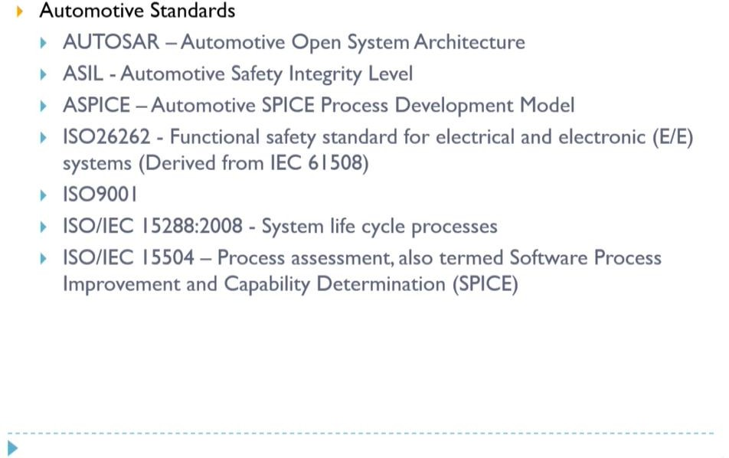
Automotive Standards
Restricted Circulation | L&T Technology Services | www.LTTS.com

Slide 24
System Design
Restricted Circulation | L&T Technology Services | www.LTTS.com

Slide 25
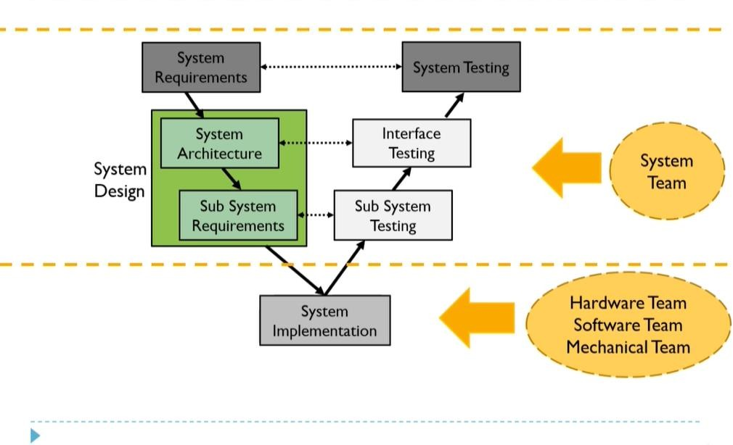
V Model
Restricted Circulation | L&T Technology Services | www.LTTS.com

Slide 26
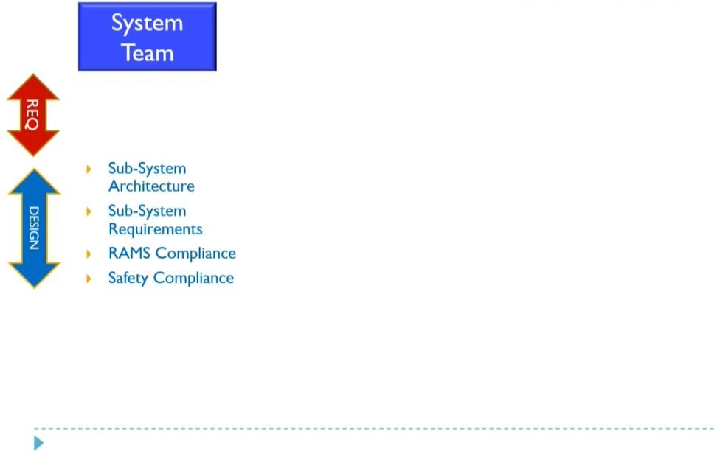
System Design
Restricted Circulation | L&T Technology Services | www.LTTS.com

Slide 27
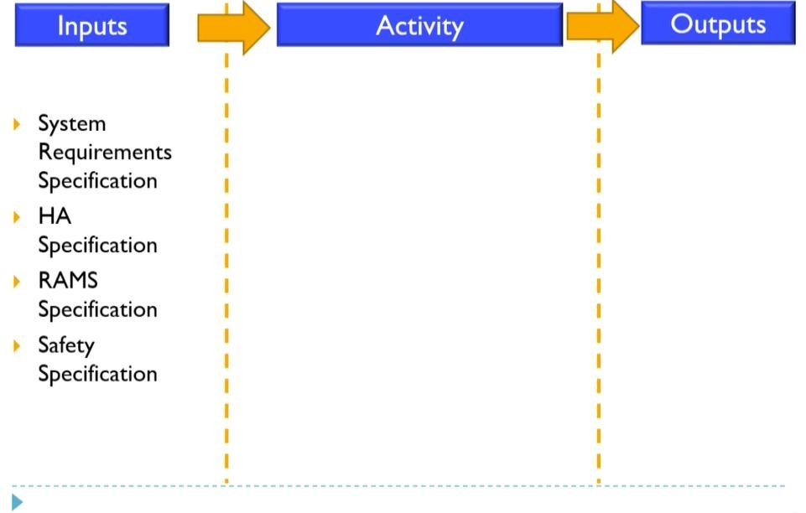
Input: System Design
Restricted Circulation | L&T Technology Services | www.LTTS.com

Slide 28
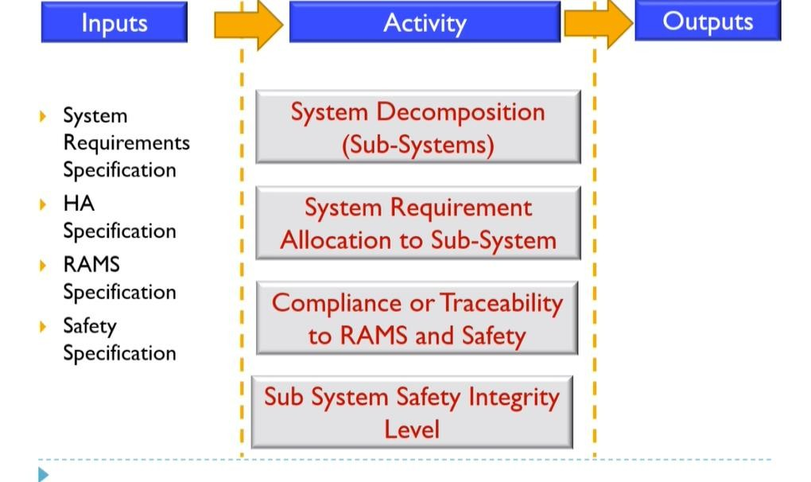
Activity: System Design
Restricted Circulation | L&T Technology Services | www.LTTS.com

Slide 29
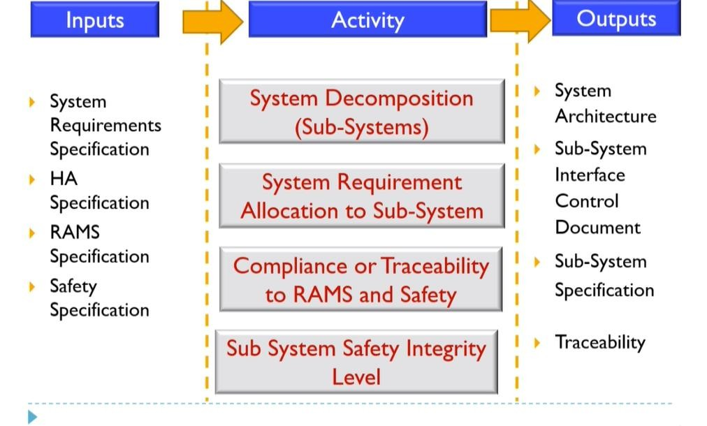
Output: System Design
Restricted Circulation | L&T Technology Services | www.LTTS.com

Slide 30
System Implementation
Restricted Circulation | L&T Technology Services | www.LTTS.com

Slide 31
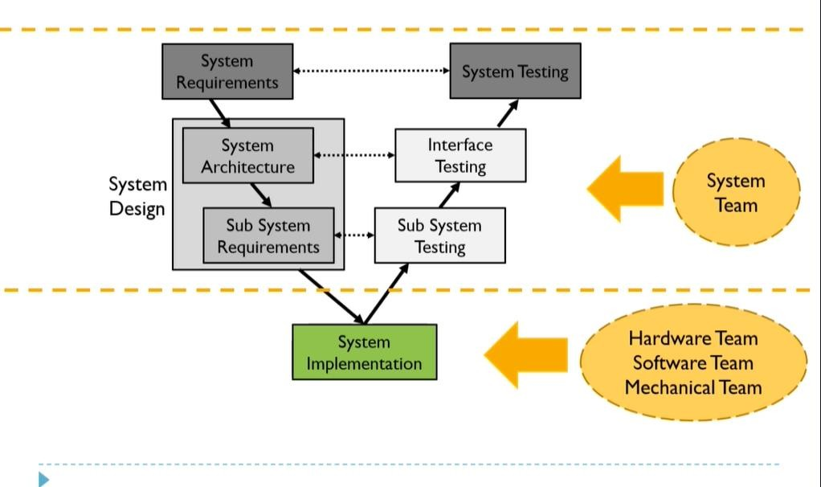
V Model
Restricted Circulation | L&T Technology Services | www.LTTS.com
31

Slide 32
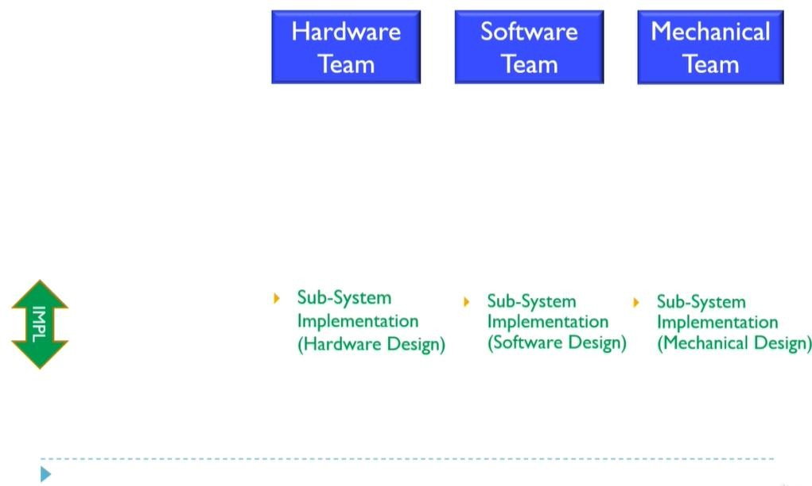
System Implementation
Restricted Circulation | L&T Technology Services | www.LTTS.com
32

Slide 33
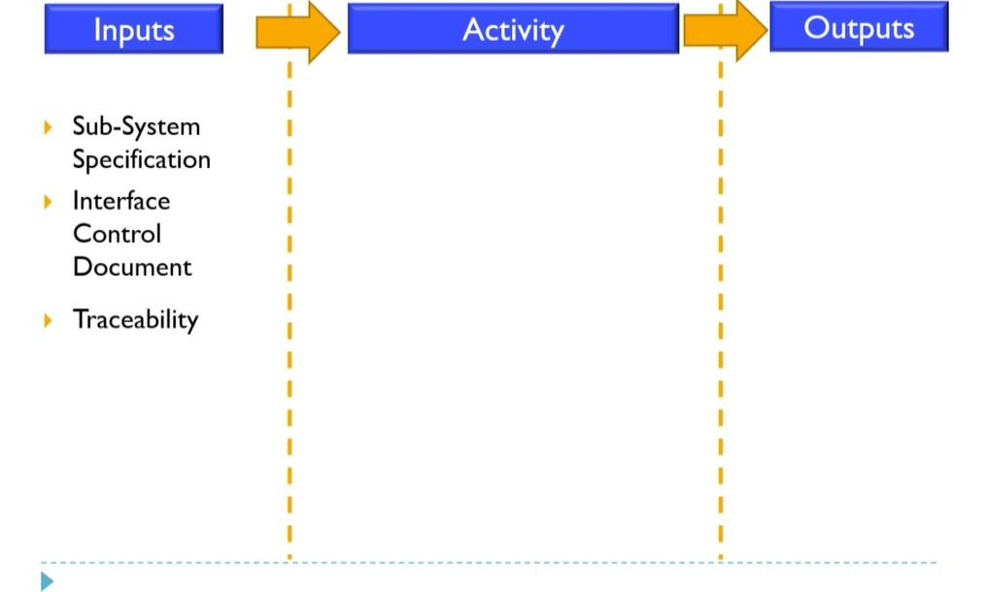
Input: System Implementation
Restricted Circulation | L&T Technology Services | www.LTTS.com

Slide 34
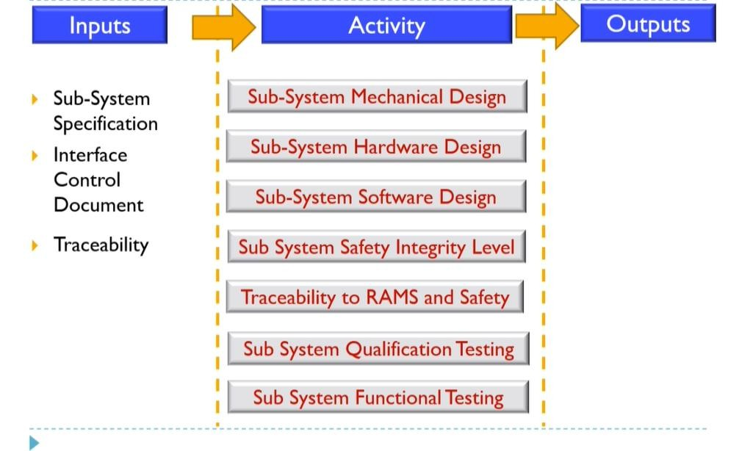
Activity: System Implementation
Restricted Circulation | L&T Technology Services | www.LTTS.com

Slide 35
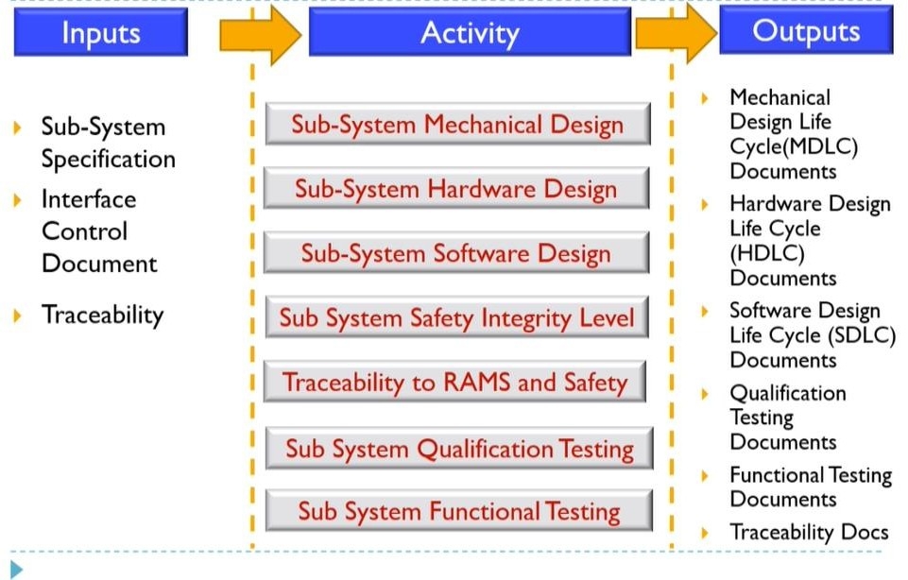
Output: System Implementation
Restricted Circulation | L&T Technology Services | www.LTTS.com

Slide 36
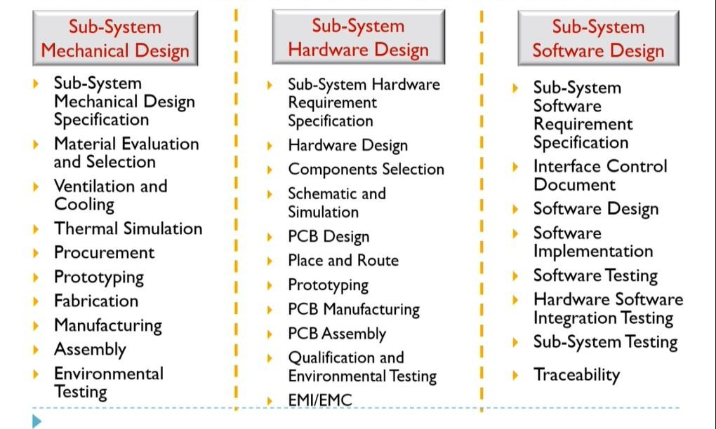
Activity: System Implementation
Restricted Circulation | L&T Technology Services | www.LTTS.com

Slide 37
System Testing
Restricted Circulation | L&T Technology Services | www.LTTS.com

Slide 38
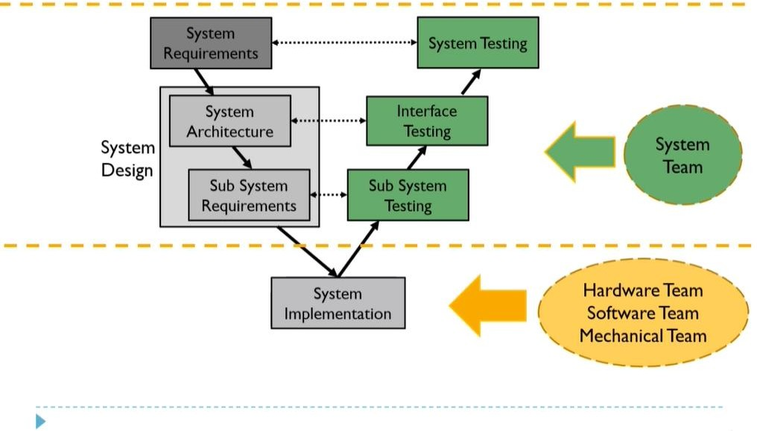
V Model
Restricted Circulation | L&T Technology Services | www.LTTS.com

Slide 39
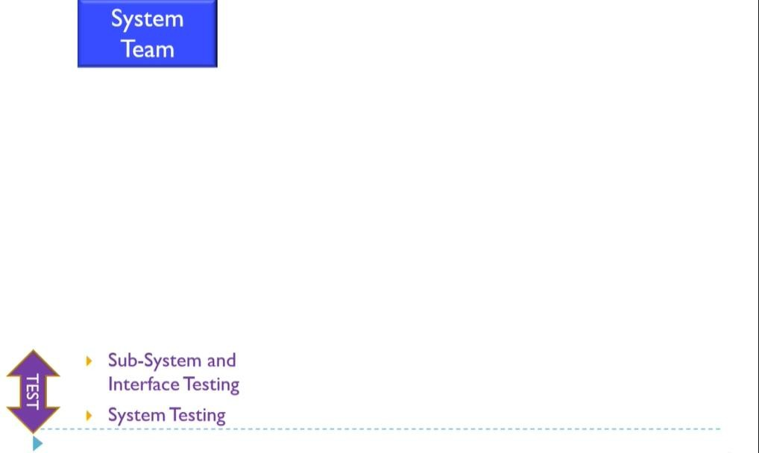
System Testing
Restricted Circulation | L&T Technology Services | www.LTTS.com

Slide 40
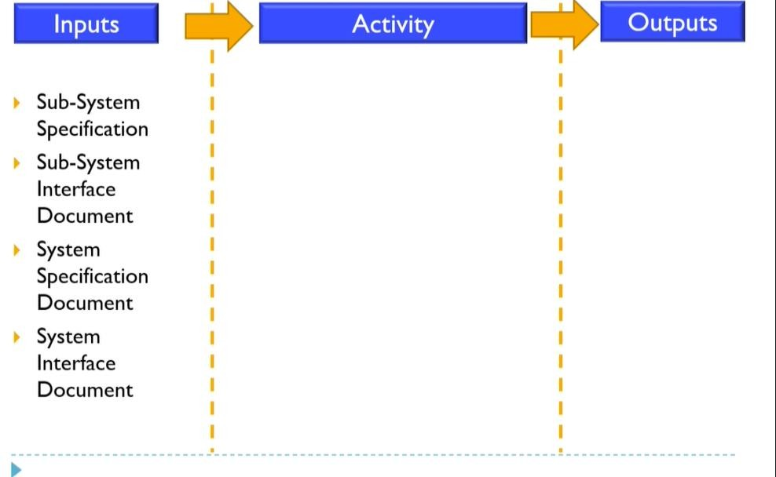
Input: System Testing
Restricted Circulation | L&T Technology Services | www.LTTS.com

Slide 41
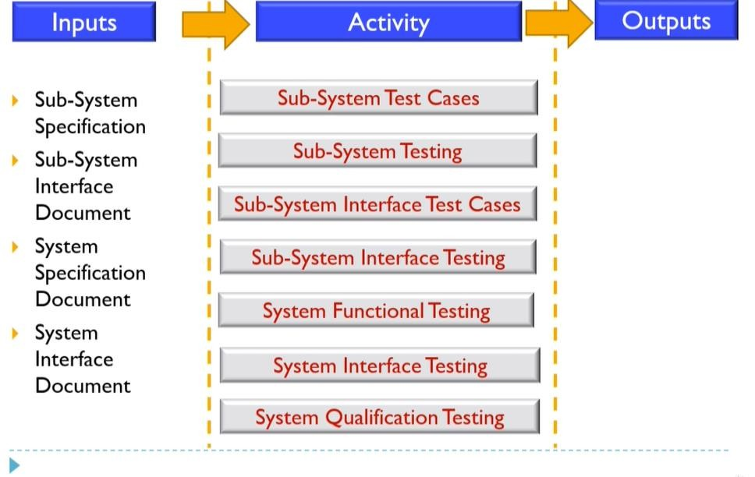
Activity: System Testing
Restricted Circulation | L&T Technology Services | www.LTTS.com

Slide 42
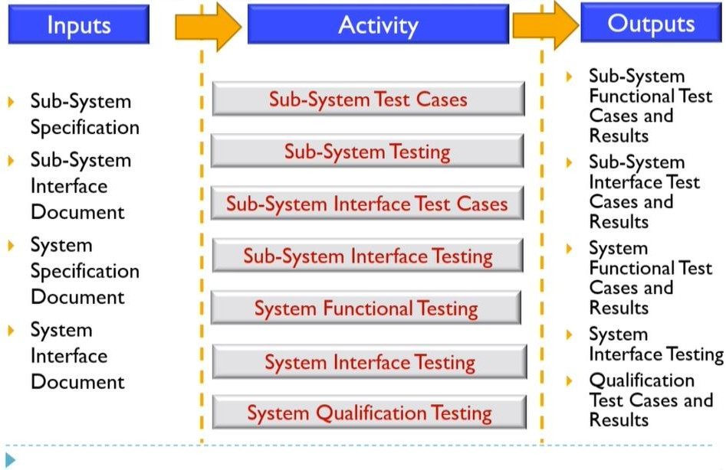
Output: System Testing
Restricted Circulation | L&T Technology Services | www.LTTS.com

Slide 43
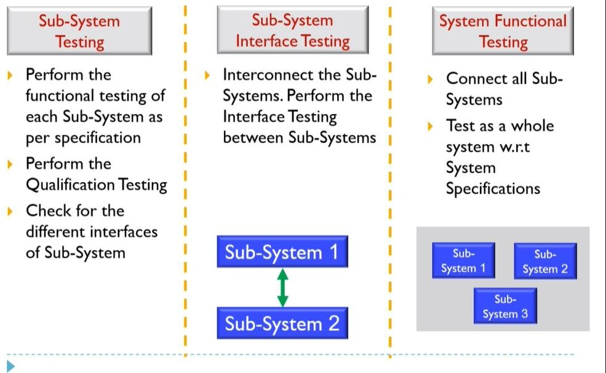
System Testing
Restricted Circulation | L&T Technology Services | www.LTTS.com

Slide 44
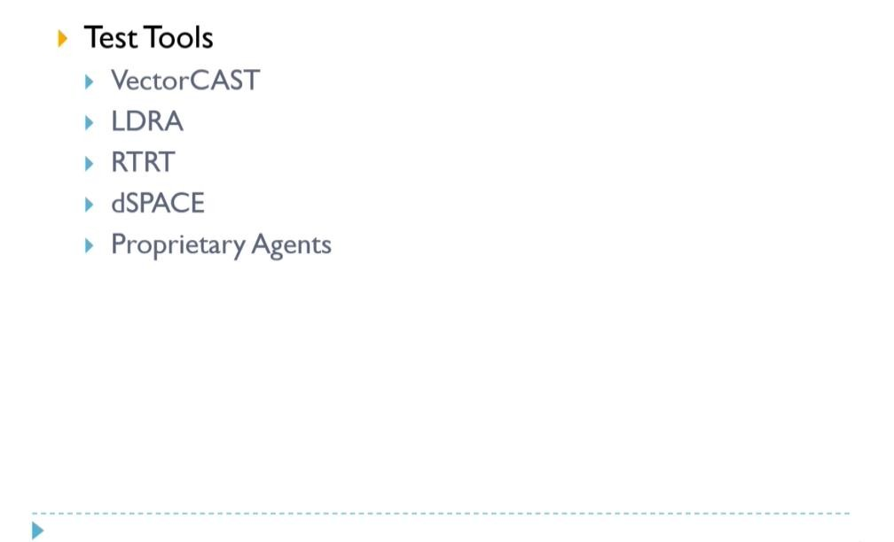
System Testing: Tools
Restricted Circulation | L&T Technology Services | www.LTTS.com

Slide 45
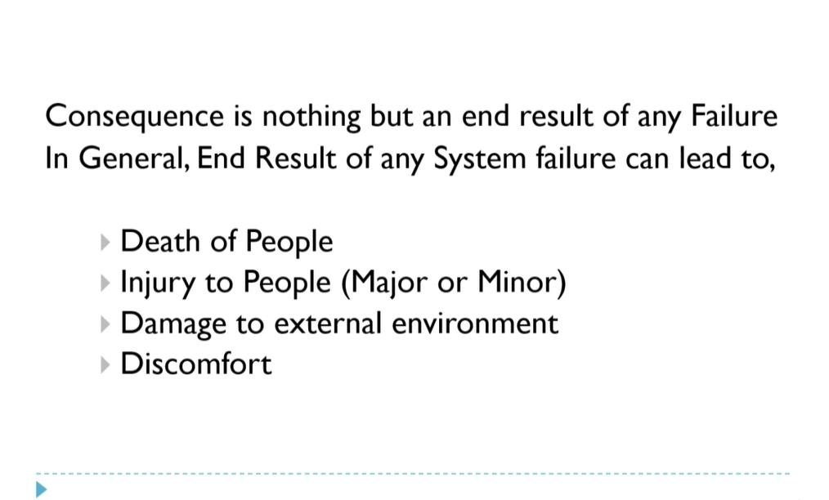
Consequence
Restricted Circulation | L&T Technology Services | www.LTTS.com

Slide 46
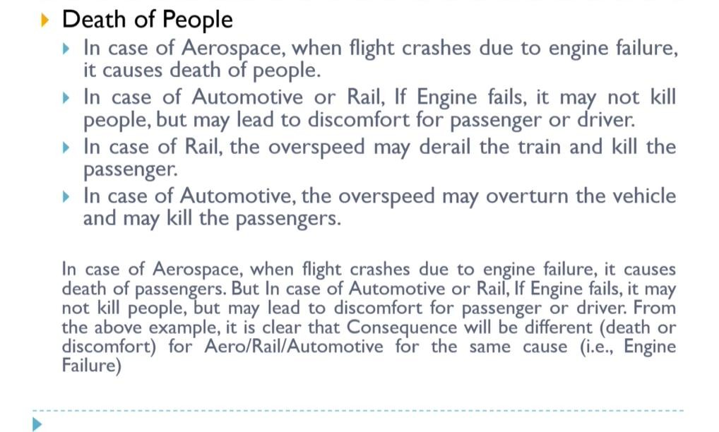
Consequence
Restricted Circulation | L&T Technology Services | www.LTTS.com

Slide 47

Thank You !

